Slide 1
Real-time Emotion Analysis Enabling Empathetic Quote
Team_No: P181
Project Advisor:
Ms.Sangitha Khare
Assistant Professor, School of Computing, Bengaluru
S.No | Reg.No | Name of the Student | Section
1 | BL.EN.U4CSE20065 | Kagolanu Venkata Chandra Madhav | CSE
2 | BL.EN.U4CSE20163 | Sreya Chowdary Karuturi | CSE
3 | BL.EN.U4CSE20196 | Asritha Veeramaneni | CSE
4 | BL.EN.U4CSE20201 | Vinnakota Sai Vivek | CSE

Slide 2
Problem Definition
This project aims to generate sympathetic quotes and recognize emotions in real-time.
Understanding and responding to human emotions are essential in today's world for human-computer connection, mental health, and education.
The main goals of the project are to create a system that can precisely identify emotions through facial expressions, analyze these expressions in detail, and provide quotations that are both contextually relevant and emotionally impactful.
The system intends to improve mental health care through emotion analysis, improve education by reacting to students' emotions, and foster more sympathetic connections with technology.
To revolutionize how technology interacts with emotions, this project blends computer vision, natural language processing, and human emotion recognition.

Slide 3
Background and Motivation
Technological Developments: The creation of real-time emotion analysis systems has been made possible by recent advances in machine learning and artificial intelligence. It is now possible to develop empathic responses in digital encounters thanks to the ability of these systems to recognize and comprehend human emotions via text, speech, and facial expressions.
The Growing Importance of Empathy: Effective communication and customer service increasingly acknowledge empathy as a crucial component. Real-time emotion analysis integrated into digital platforms enables the delivery of individualized and sympathetic services.
Applications in Education and treatment: Real-time emotion analysis has enormous promise in education and treatment. Enhancing learning results and therapeutic effectiveness, it provides individualized feedback and insights based on emotional states. It presents novel approaches to support emotional health and academic advancement by bridging the technological and emotional divide.

Slide 4
Literature Survey
Authors name(s) | Full title of the paper with Year | Inference from paper (based on methodology, technology) | Open Problem
A. Dixit, M. Vashishtha, K. Guleri | "An AI-based Formulated Feedback-System for Interpreting Conclusive Emotions for A Group of People," 2022 | This system is designed to analyze and interpret strong and definitive emotions within a group context. The research likely delves into the methodology and technology employed, possibly incorporating machine learning techniques for emotion recognition. Paper's implications may extend to various fields, such as healthcare, education, and human-computer interaction, where understanding collective emotions can be valuable for improving communication and decision-making processes. (Conference Paper) | One potential open problem highlighted in this paper could be the scalability and generalization of the AI-based feedback system for interpreting conclusive emotions. It may be important to address how the system's performance varies across different group sizes, cultural contexts, or languages, and whether it can adapt effectively to diverse real-world scenarios beyond controlled environments.
S. A. M. Silveira, V. P. Mishra | "Development of Simulator to Recognize the Mood using Facial Emotion Detection," 2022 | This suggests the application of computer vision and machine learning techniques to analyze facial expressions for emotional cues. The research could have implications in areas like human-computer interaction and mental health assessment. Further insights into the methodology, technology, and potential applications would be gained by reading the full paper, including abstract, methodology, results, and conclusions.(Conference Paper) | An open problem arising from this paper may involve addressing the potential limitations of the developed mood recognition simulator, such as its accuracy and robustness across diverse demographic groups, different lighting conditions, or variations in facial expressions. It could also explore the real-world applicability and ethical considerations associated with deploying such technology for mood recognition.
Have studied ~15 papers. From these papers, 4 representative papers are presented here.

Slide 5
Literature Survey
Authors name(s) | Full title of the paper with Year | Inference from paper (based on methodology, technology) | Open Problem
S. J. Rennie, E. Marcheret, Y. Mroueh, J. Ross, V. Goel | "Self-Critical Sequence Training for Image Captioning," 2017 | This method likely involves training a neural network to generate image descriptions and then refining those descriptions by evaluating their quality using reinforcement learning. By utilizing a self-critical sequence training approach, the paper likely addresses the challenge of generating more accurate and contextually relevant captions for images, which has applications in fields like computer vision, natural language processing, and accessibility technologies. (Conference Paper) | The models struggle with generating truly creative or contextually rich image descriptions.
A. Karpathy, L. Fei-Fei | "Deep visual-semantic alignments for generating image descriptions," 2015 | The research likely explores the alignment of visual and semantic information by training deep neural networks to associate images with descriptive text. This work is pivotal in the field of computer vision and natural language processing, aiming to bridge the gap between visual content and textual understanding. The resulting models could have diverse applications, such as automated image captioning and improving accessibility for visually impaired individuals. Detailed insights into methodology and experimental results can be found in the full paper. (Journal) | The limitations of "Deep visual-semantic alignments for generating image descriptions" (2015) ,include challenges in handling complex, nuanced relationships between images and text, potential overfitting to specific datasets, and sensitivity to the quality and quantity of training data. Additionally, the models may struggle with generating truly creative or contextually rich image descriptions.
Have studied ~15 papers. From these papers, 4 representative papers are presented here.

Slide 6
Literature Survey
Authors name(s) | Full title of the paper with Year | Inference from paper (based on methodology, technology) | Open Problem
S. Palaniswamy and Suchitra | "A Robust Pose & Illumination Invariant Emotion Recognition from Facial Images using Deep Learning for Human-Machine Interface“,2019 | The topic of this 2019 paper by S. Palaniswamy and Suchitra is emotion recognition from facial photos. Deep learning techniques are used to make the system robust to changes in position and lighting. The technology probably uses deep neural networks, which can deal with complex visual data, making it appropriate for applications requiring emotion interpretation from images and for use in human-machine interfaces. (Journal) | They have achieved an overall accuracy of 96.55% with an average processing time of approximately 4 mins for more than 10,000 facial images which is relatively slow for real time processing. Real-time applications typically require much faster processing times, often in milliseconds or a few seconds per frame.
S. Giri et al | "Emotion Detection with Facial Feature Recognition Using CNN & OpenCV“,2022 | This work, written in 2022 by S. Giri and collaborators, focuses on facial image emotion recognition. For feature recognition, it makes use of Convolutional Neural Networks (CNN) and OpenCV, indicating a deep learning strategy for facial emotion analysis. To develop emotion recognition technologies, the methodology probably comprises picture preprocessing with OpenCV and CNNs to extract facial features. (Conference paper) | They have used EDR(Endpoint detection and response) which is not able to identify threats that exist outside of the network. In many cases, they also require manual intervention in order to respond appropriately, meaning there may be a delay in taking action.

Slide 7
Literature Survey
Authors name(s) | Full title of the paper with Year | Inference from paper (based on methodology, technology) | Open Problem
Q. You, H. Jin, Z. Wang, C. Fang, and J. Luo | "Image Captioning with Semantic Attention“,2016 | In this research, They offered team a novel method for captioning images that makes use of semantic attention mechanisms. It provides a novel method for producing picture descriptions by concentrating on areas of an image that are semantically significant. Deep neural networks and attention mechanisms are probably used in the methodology, which advances the fields of computer vision and picture understanding.(Journal) | Semantic attention mechanisms in neural networks can lead to overfitting and require significant computational resources. To mitigate these challenges, natural language processing employs techniques like transfer learning and pre-trained models, enhancing efficiency and generalization.
S. J. Rennie, E. Marcheret, Y. Mroueh, J. Ross, and V. Goel | "Self-Critical Sequence Training for Image Captioning“,2017 | In their 2017 publication, S. J. Rennie and colleagues offer "Self-Critical Sequence Training," a revolutionary method for captioning images. This approach aims to enhance the quality of neural network-generated image captions. The methodology presumably uses sequence generation and reinforcement learning techniques, advancing the study of computer vision and the creation of visual descriptions. (Conference paper) | One drawback of self-critical sequence training for image captioning is its high computational demand, making it less suitable for real-time applications. It may also result in captions that are overly safe and lack creativity due to the optimization process, which can prioritize common captions.
Have studied ~15 papers. From these papers, 8 representative papers are presented here.

Slide 8
Justification for the proposed problem
The proposed issue has significant influence in the current digital world. Systems that can recognize emotions and respond empathically have the potential to change several industries.
Customized teaching strategies can greatly enhance student learning outcomes in the classroom.
Personalized therapies and more accurate emotion evaluation can both be beneficial in mental health care.
User-centric technology experiences are the result of improved human-computer interactions.
This project seeks to close the gap between human emotions and technology by fusing state-of-the-art computer vision and natural language processing technologies.
The resulting solution is a unique and worthwhile endeavour since it offers a novel strategy for addressing problems in the real world and has numerous applications.

Slide 9
Software/Tools Requirements
• CPU / GPU machine for computation
• Python environment
• Streamlit/React JS
• TensorFlow
• Scikit-Learn
• Open-CV
• Pandas
• Facial recognition and emotion detection libraries (e.g., dlib, OpenCV with Haar cascades or deep learning models)
• Natural Language Processing (NLP) libraries (e.g., NLTK, spaCy, GPT-based models)

Slide 10
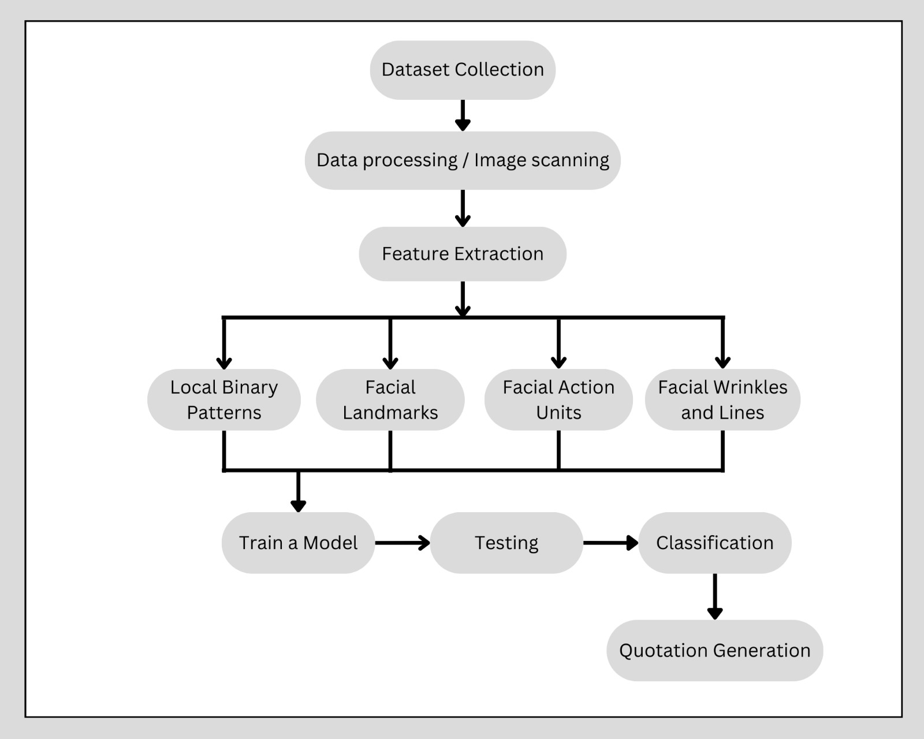
Architecture / Design

Slide 11
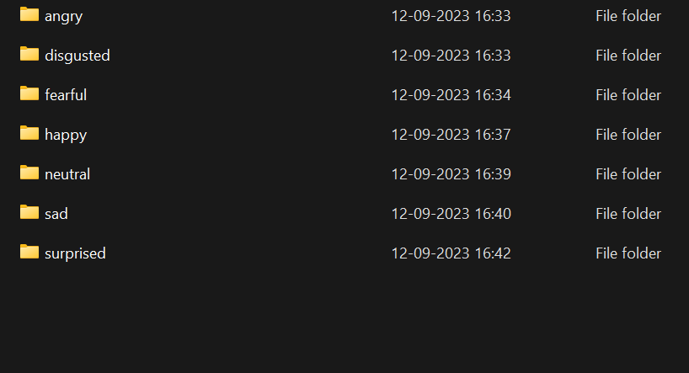


Data Set
FER-2013 dataset includes seven different emotion types:The dataset consists of 35,685 instances of grayscale 48x48 pixel images of faces split into a train and test dataset.
Based on the emotion expressed in the facial expressions, images are categorised into categories including happiness, neutrality, sadness, anger, surprise, disgust, and fear.
Happy
Sad

Slide 12



Camera Captured Documents
The captured image is well-composed and clearly conveys a sense of happiness.
The captured image unmistakably reflects the man's surprise.
The captured image is blurry, making it difficult to discern any emotions.

Slide 13
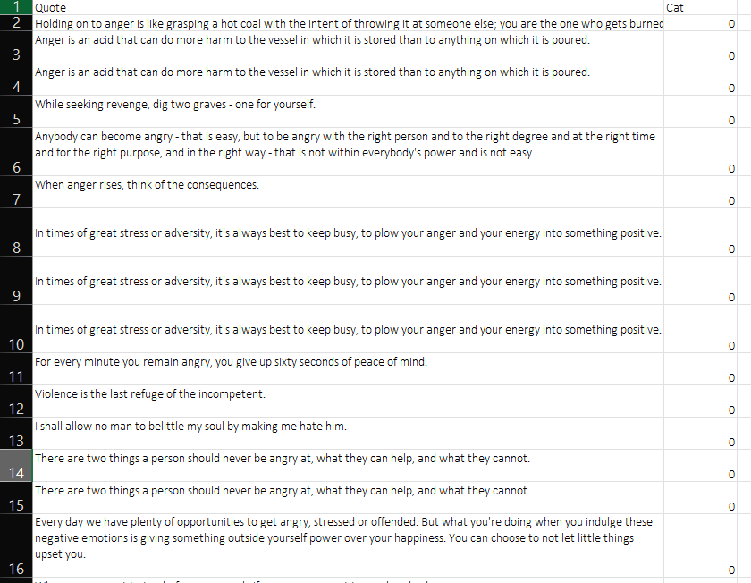
Quotes Excel:
The dataset consists of 141 rows containing 140 quotes, each accompanied by an emotion category label. Quote: Textual content of the quotes.
Cat: Emotion category label (0 for angry, 1 for disgusted, 2 for fearful, 3 for happy, 4 for neutral, 5 for sad, 6 for surprised).
Total Rows: 141
Quotes: 140
The dataset is designed to explore the emotional nuances within a collection of quotes, providing labeled data for emotion analysis and sentiment classification.
Emotion Categories:
0: Angry
1: Disgusted
2: Fearful
3: Happy
4: Neutral
5: Sad
6: Surprised

Slide 14
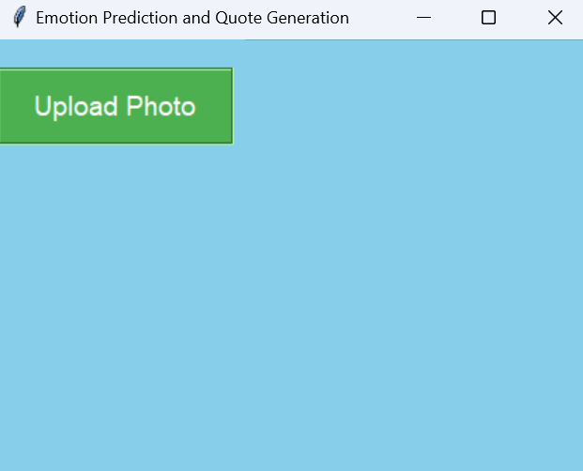
User Interface

Slide 15
A basic graphical user interface (GUI) application for emotion prediction based on a pre-trained convolutional neural network (CNN) model was developed using the Tkinter framework.
The program allows users to input images, and then utilizes a trained model to identify the emotion in the photos.
In the GUI, the uploaded image and the anticipated emotion are shown together. After loading the CNN model from a given file path, the emotions are mapped to the appropriate labels so they may be seen.

Slide 16
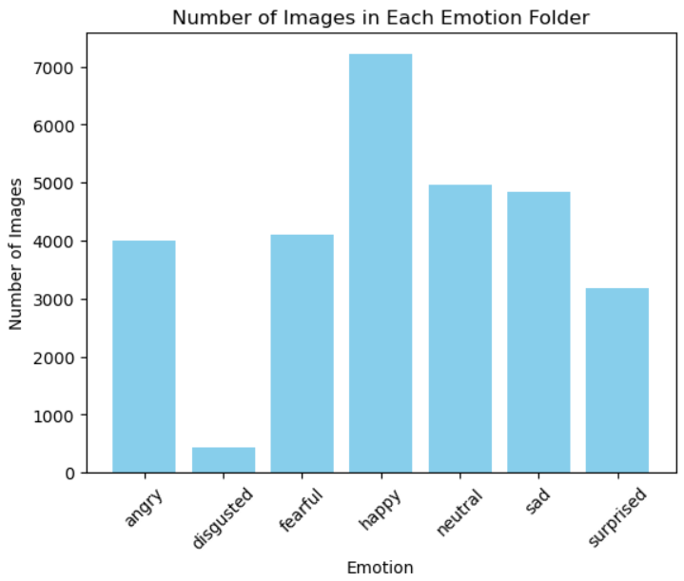
Images In Each Emotion Folder

Slide 17
CNN
Over the past year, CNN has delivered in-depth reports on Real-time Emotion Analysis.
First, we loaded and preprocessed data into greyscale and converted images into 48 x 48 pixels.
Normalize pixel values between 0 and 1 and perform one-hot encoding.
Adds Convolutional and Pooling layers, followed by Flatten and Dense layers.
Uses the SoftMax activation function for the output layer.
Compiles the model using the Adam optimizer and categorical cross-entropy loss.
Training the model for a specified number of epochs (30).

Slide 18
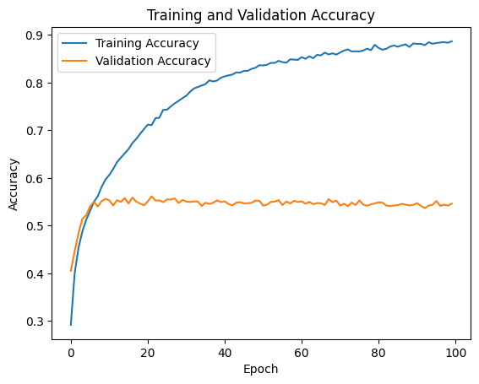
The test accuracy we got for the pre-trained model is 56.298%.

Slide 19
VGG16
Convert images to grayscale, resize to a common size (48x48 pixels), and store in X_train and X_test.
It utilizes 16 layers with weights(13 CNN & 3 Fully Connected).
The convolutional layers are followed by three fully connected layers.
The fully connected layers serve as the classifier, ultimately producing the output probabilities for different classes.
The convolutional layers use small 3x3 filters with a stride of 1, and max-pooling layers are used to reduce spatial dimensions.
Dropout is applied to the fully connected layers for regularization, helping prevent overfitting and we have used adam optimizer.

Slide 20
In VGG16 there are thirteen convolutional layers, five Max Pooling layers, and three Dense layers which sum up to 21 layers
Conv-1 Layer has 64 number of filters, Conv-2 has 128 filters, Conv-3 has 256 filters, Conv 4 and Conv 5 has 512 filters.
After the training we Plotted the training and validation accuracy over epochs(10).

Slide 21
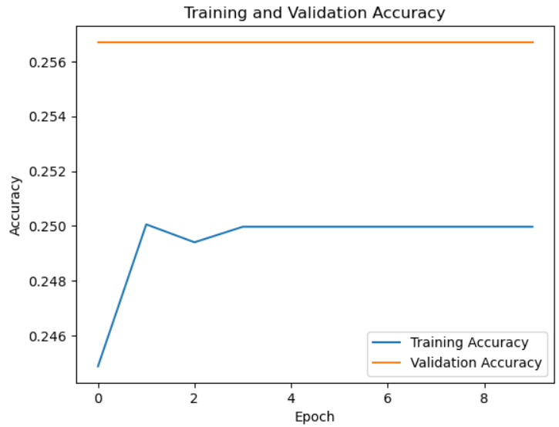
The test accuracy we got for the pre-trained model is 26.825%.

Slide 22
Shallow CNN
The Shallow Convolutional Neural Network (CNN) architecture comprises a Convolutional Layer with 32 filters, a 3x3 window, and ReLU activation, followed by a Max-Pooling Layer with a 2x2 pool size for down sampling.
The Flattening Layer converts the output to a one-dimensional vector.
A Dense Layer with 128 units and ReLU activation is employed to learn high-level features.
To prevent overfitting, a Dropout layer with a dropout rate of 0.5 is incorporated after the dense layer.
These layers collectively enable the network to capture hierarchical features from the input images.

Slide 23
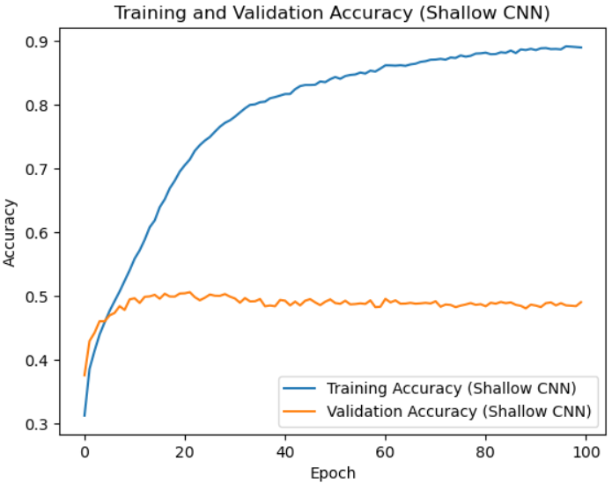
The test accuracy we got for the pre-trained model is 49.054%.

Slide 24
MobileNetV2
Data Processing - Grayscale conversion, resizing, and splitting into training and testing sets.
Normalization and Encoding - Pixel normalization and one-hot encoding of labels.
Model Architecture - MobileNetV2 base with added layers for grayscale adaptation.
Training and Validation - Model training for 15 epochs with validation set monitoring.
Evaluation - Model evaluation on the test set, displaying test accuracy
Visualization - Plotting training and validation accuracy over epochs.
Transfer Learning - Leveraging MobileNetV2 pre-trained on ImageNet for feature extraction.

Slide 25
Dropout for Regularization - Applying dropout (0.5) to prevent overfitting.
Model Complexity - Architecture includes global average pooling, dense layers, and softmax output.
Final Outcome - Succinct summary of the entire process and results.

Slide 26
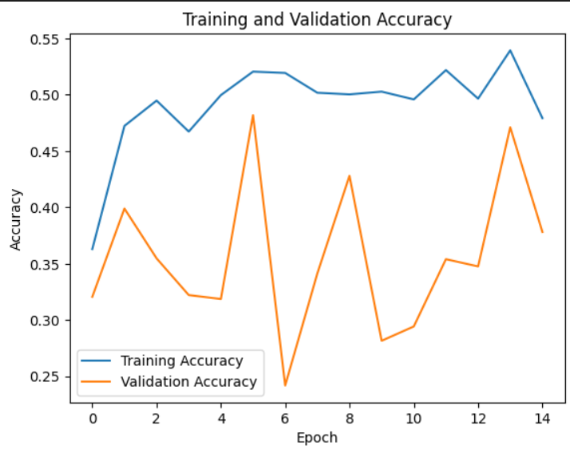
The test accuracy we got for the pre-trained model is 40.20%.

Slide 27
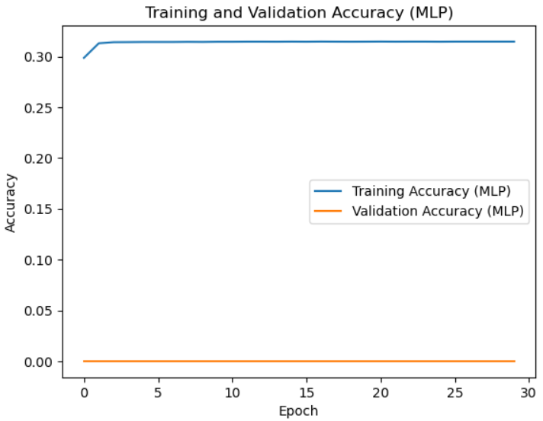
The test accuracy we got for the pre-trained model is 26.84%.

Slide 28
MLP
Data Processing - Grayscale conversion and flattening of images for MLP input.
Normalization and Encoding - Pixel normalization and one-hot encoding of labels.
MLP Model Definition - Sequential model with dense layers (128, 64), dropout for regularization, and softmax output.
Training and Validation - Model training for 30 epochs with a batch size of 32 and 20% validation split.
Evaluation - Model evaluation on the test set, displaying test accuracy.
Visualization- Plotting training and validation accuracy for the MLP model.
Outcome - Test accuracy for the MLP model is printed and training history is visualized.

Slide 29
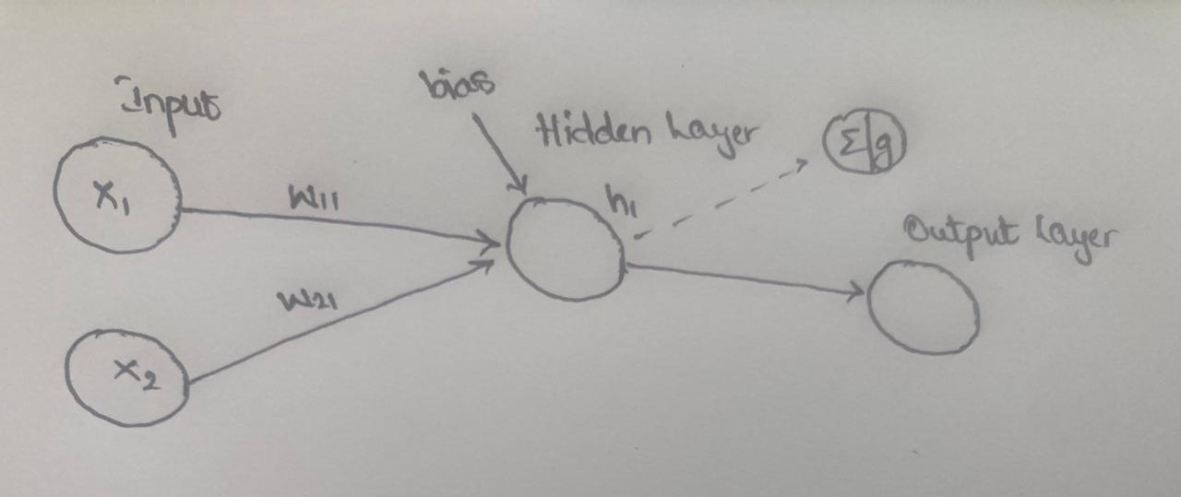
FNN
Perceptron

Slide 30
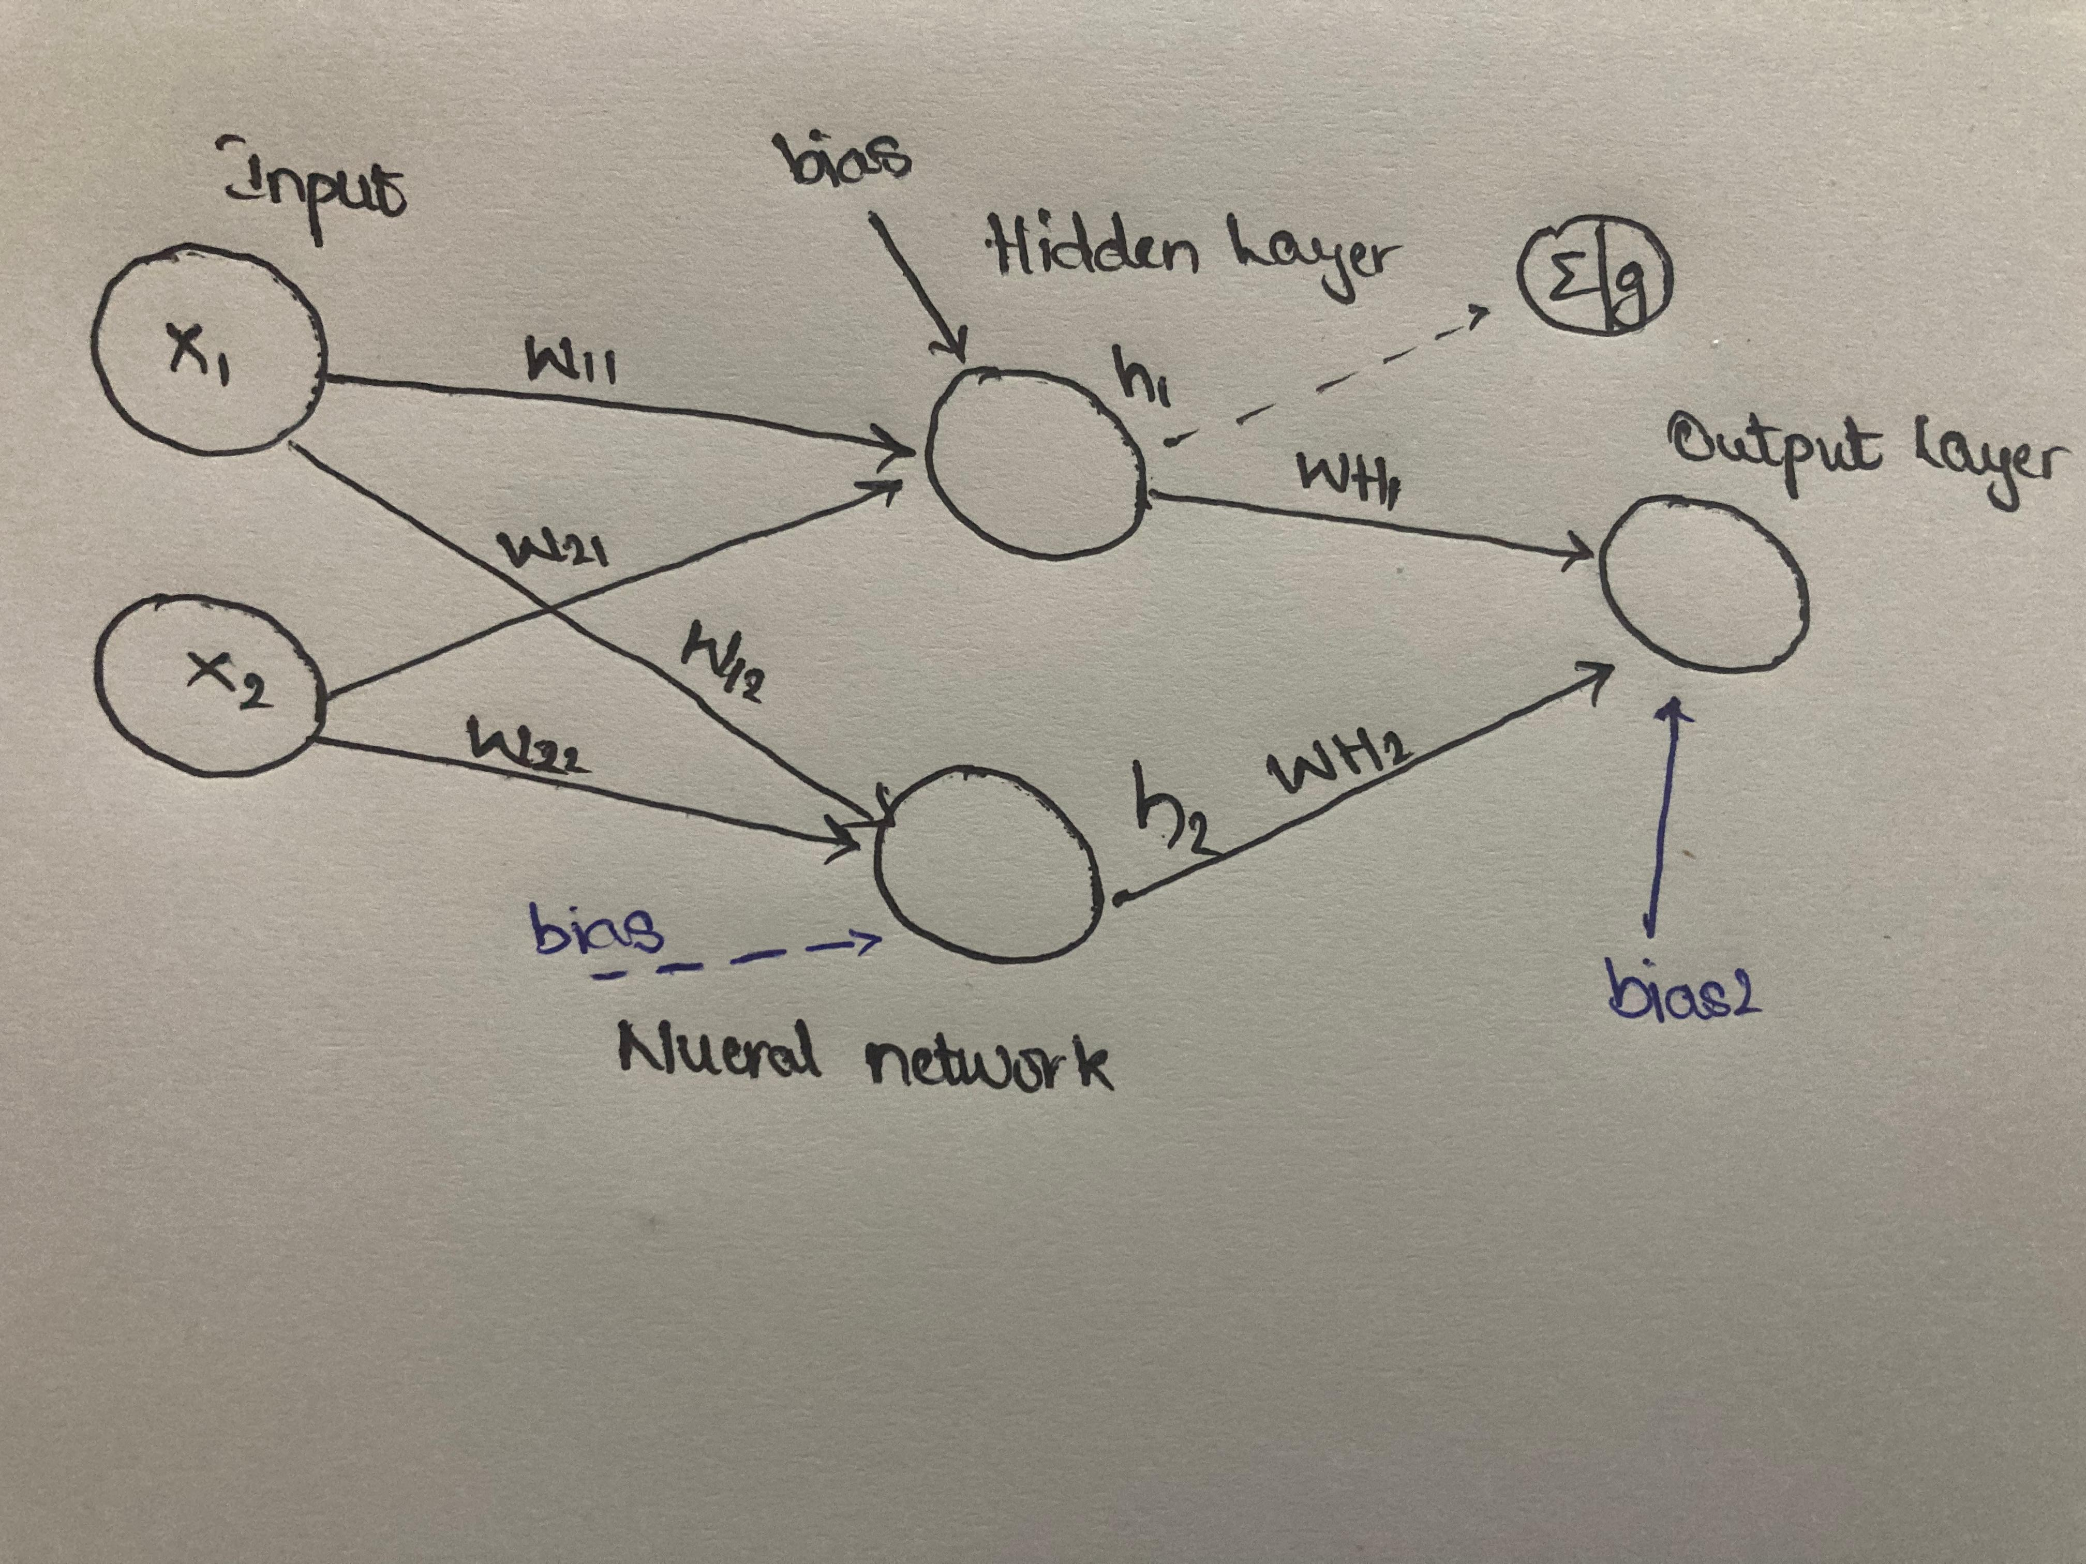

Slide 31
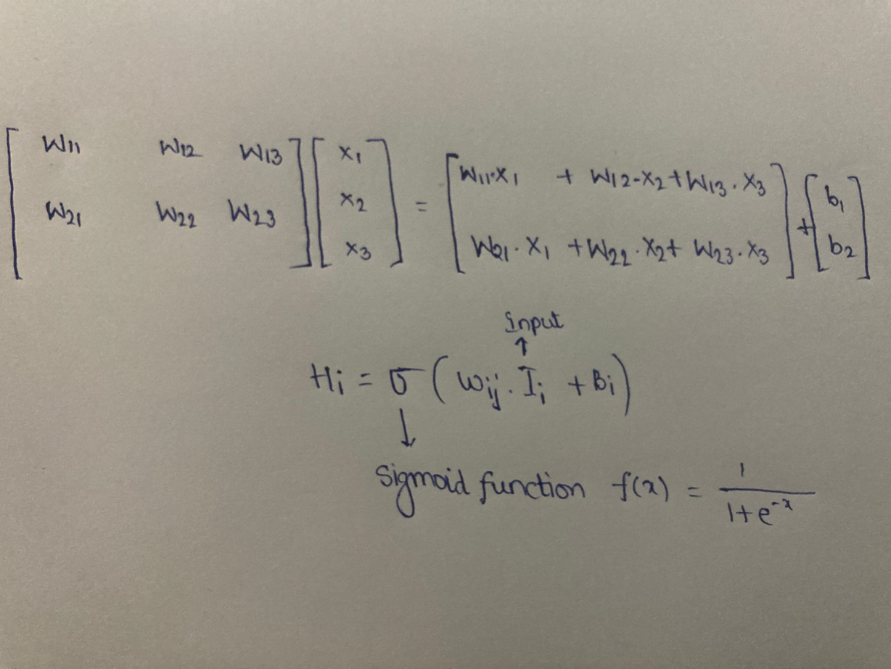

Slide 32
Input Layer (Flatten): Flatten(input_shape=(48*48,)): This layer flattens the input, which is a 48x48 grayscale image.
Hidden Layers (Dense with ReLU activation):Dense(256, activation='relu'): The first dense layer consists of 256 neurons (or units) with Rectified Linear Unit (ReLU) activation.
This layer is responsible for learning complex patterns in the input data.
It randomly sets a fraction (50%) of input units to zero during training to prevent overfitting.
Dense(128, activation='relu'): The second dense layer consists of 128 neurons with ReLU activation.
Dropout(0.5): dropout layer for regularization.Output Layer (Dense with Softmax activation): Dense(num_classes, activation='softmax'): The output layer has neurons equal to the number of classes (num_classes).
It uses the softmax activation function, which is suitable for multi-class classification problems. The softmax function normalizes the output into a probability distribution over the classes.

Slide 33
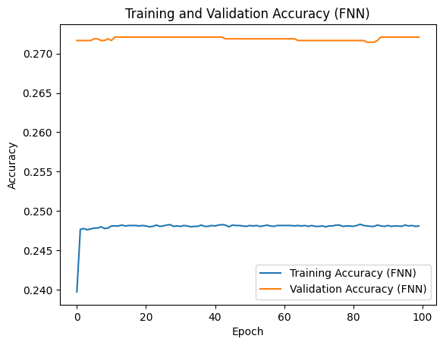
The test accuracy we got for the pre-trained model is 24.74%.

Slide 34
GRU
Normalization:
Pixel values are normalized to the range [0, 1] for effective model training.
One-Hot Encoding:
Emotion labels are one-hot encoded to facilitate categorical classification.
GRU Model Definition:
The GRU model is defined using the TensorFlow Keras API.
Two GRU layers with 256 and 128 units, respectively, are employed.
Dropout layers with a rate of 0.5 follow each GRU layer for regularization.
The final dense layer uses softmax activation for multi-class classification.
Model Compilation and Training :
The model is compiled using the 'adam' optimizer and categorical crossentropy loss.
The GRU model is trained for 100 epochs with a batch size of 32.
Validation data, comprising 20% of the training set, is used for monitoring model performance during training.

Slide 35
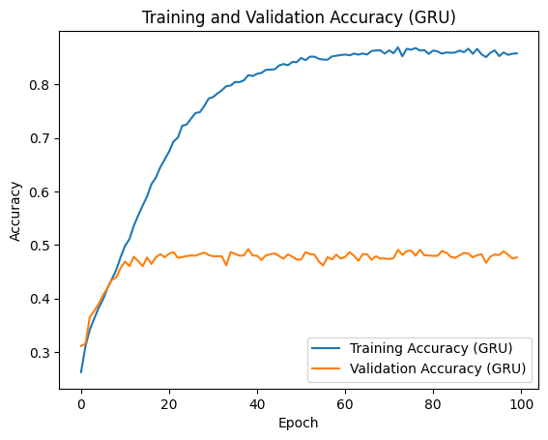
The test accuracy we got for the pre-trained model is 46.78%.

Slide 36
RNN
Normalization:
Pixel values are normalized to the range [0, 1] for effective model training.
One-Hot Encoding:
Emotion labels are one-hot encoded to facilitate categorical classification.
GRU Model Definition:
The GRU model is defined using the TensorFlow Keras API.
Two GRU layers with 256 and 128 units, respectively, are employed.
Dropout layers with a rate of 0.5 follow each GRU layer for regularization.
The final dense layer uses softmax activation for multi-class classification.
Model Compilation and Training :
The model is compiled using the 'adam' optimizer and categorical crossentropy loss.
The GRU model is trained for 100 epochs with a batch size of 32.
Validation data, comprising 20% of the training set, is used for monitoring model performance during training.

Slide 37
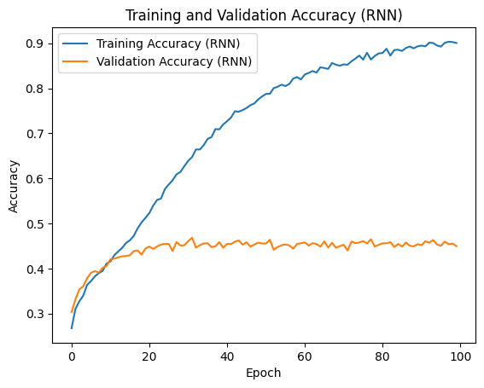
The test accuracy we got for the pre-trained model is 46.32%.

Slide 38
LSTM
Temporal Understanding:
LSTM layers, with 256 and 128 units, serve as the maestros in capturing temporal intricacies within facial expression images.
This temporal understanding enables the model to discern nuanced emotional changes over sequential data, offering a richer interpretation of the conveyed feelings.
Harmonious Training Symphony:
The model undergoes a 100-epoch rehearsal, akin to a ballet, with 32 images gracefully performing in each batch. A validation dance, featuring 20% of the training data, provides critical feedback for the LSTM model's refinement, ensuring it gracefully adapts to the emotional notes expressed in the images.
Visual Crescendo of Accuracy:
The model's journey unfolds visually, charting the evolving harmony between the LSTM layers and the emotional expressions within each epoch.
The conclusive test accuracy becomes the final chord, resonating with the audience and symbolizing the LSTM model's adeptness in decoding and recognizing emotions from facial expressions.

Slide 39
The test accuracy we got for the pre-trained model is 46.32%.

Slide 40
DenseNet169
Base Model:
The model utilizes the DenseNet169 architecture as a base model. DenseNet is known for its densely connected blocks, where each layer receives direct input from all preceding layers. This promotes feature reuse and can lead to more efficient training and improved parameter efficiency.
Global Average Pooling:
After the DenseNet169 base, a Global Average Pooling 2D layer is applied. Global Average Pooling is a downsampling technique that computes the average of each feature map in the final convolutional layer. It reduces the spatial dimensions to 1x1 while retaining important feature information, helping to reduce the total number of parameters.
Dense Layers with Dropout:
Following the Global Average Pooling layer, there are several fully connected (dense) layers. These layers serve as the classifier for the specific task at hand. Dropout layers are included after the dense layers to prevent overfitting. Dropout randomly sets a fraction of input units to zero during training, which helps prevent the model from relying too much on specific activations.

Slide 41
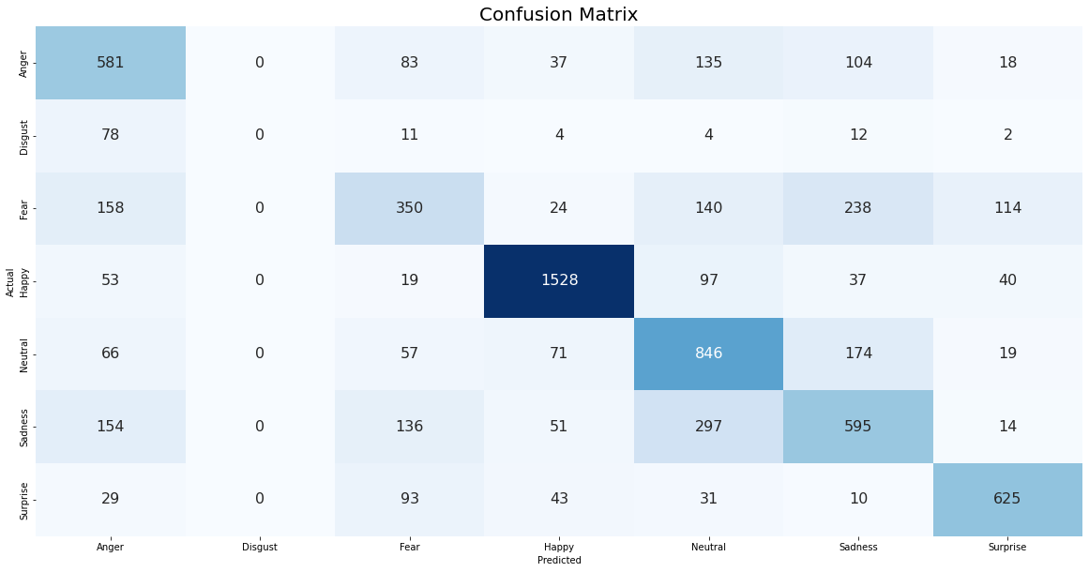
The test accuracy we got for the pre-trained model is 63.04%.

Slide 42
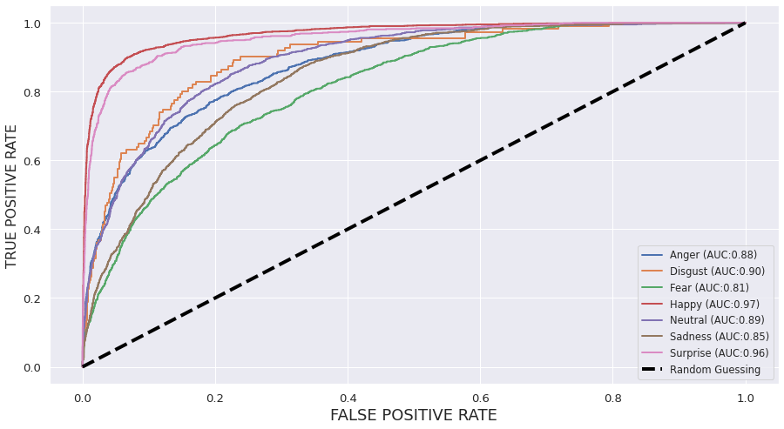
ROC AUC Score:91.76%
ROC AUC score: 0.9176808669193763

Slide 43
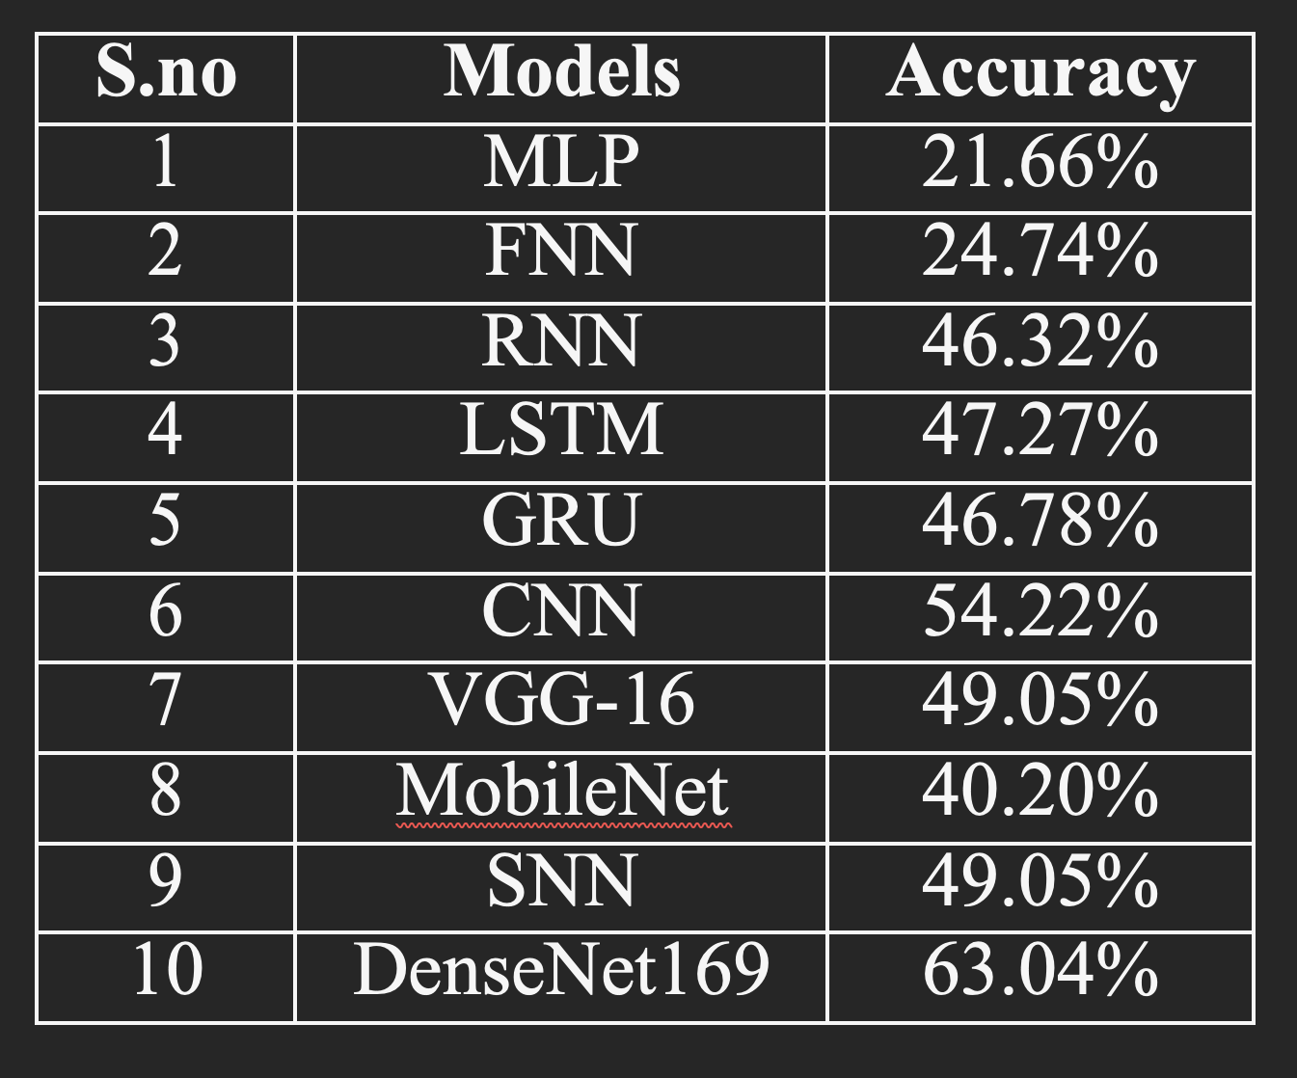
Comparison

Slide 44
BERT
Fine-tuning BERT for Emotion Classification:
Dataset Loading: Reads a dataset from an Excel file containing quotes labeled with emotion categories.
Tokenization: Uses the BERT tokenizer to encode input texts and convert labels to PyTorch tensors.
Model Definition: Initializes a BERT model for sequence classification.
Training: Fine-tunes the BERT model on the emotion classification task using a
DataLoader, AdamW optimizer, and CrossEntropyLoss.
Evaluation: Evaluates the model on a validation set and prints the accuracy.
Model Saving: Saves the fine-tuned model and tokenizer for later use.

Slide 45
GPT2
Generating Quotes with GPT-2:
Model Loading:
Loads a pre-trained GPT-2 model and tokenizer for TensorFlow.
Quote Generation:
Defines a function (generate_quote_with_gpt2) that takes a prompt (including a detected emotion) and generates a quote using GPT-2.
Example Usage:
Demonstrates the use of GPT-2 to generate a quote based on a detected emotion ("sad" in this case).

Slide 46
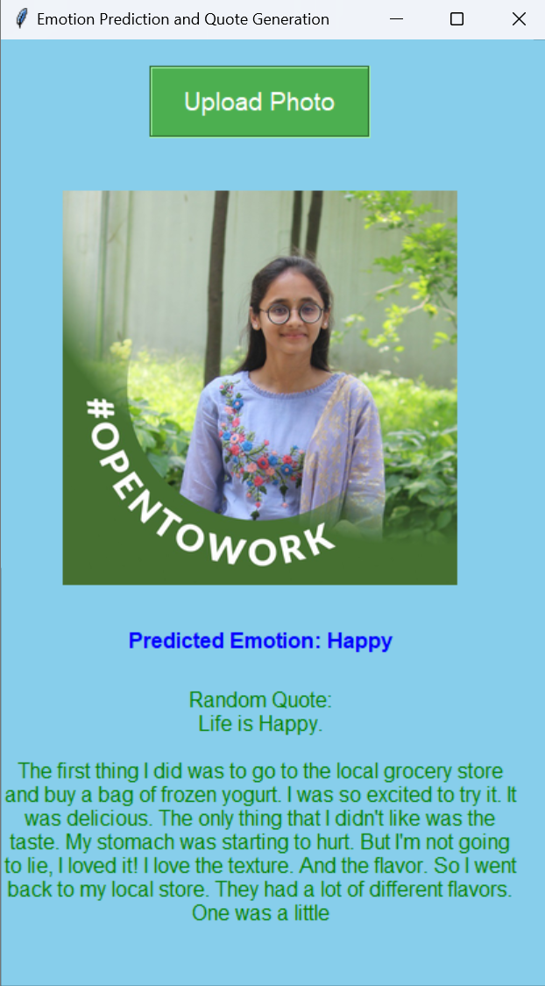
Output

Slide 47
Timeline
Abstract Submission
29/8/2023
Literature Survey
7/9/2023
Design
14/9/2023
Partial Implementation
2/10/2023
Full Implementation
30/11/2023
Website/
Mobile app
10/12/2023
Testing and Deployment
12/12/2023
Report submission and paper publishing
4/1/2024

Slide 48
Bibliography
S. Palaniswamy and Suchitra, "A Robust Pose & Illumination Invariant Emotion Recognition from Facial Images using Deep Learning for Human-Machine Interface," 2019 4th International Conference on Computational Systems and Information Technology for Sustainable Solution (CSITSS), Bengaluru, India, 2019, pp. 1-6, doi: 10.1109/CSITSS47250.2019.9031055.
A. A. Nugraha, A. Arifianto and Suyanto, "Generating Image Description on Indonesian Language using Convolutional Neural Network and Gated Recurrent Unit," 2019 7th International Conference on Information and Communication Technology (ICoICT), Kuala Lumpur, Malaysia, 2019, pp. 1-6, doi: 10.1109/ICoICT.2019.8835370.
S. Giri et al., "Emotion Detection with Facial Feature Recognition Using CNN & OpenCV," 2022 2nd International Conference on Advance Computing and Innovative Technologies in Engineering (ICACITE), Greater Noida, India, 2022, pp. 230-232, doi: 10.1109/ICACITE53722.2022.9823786.

Slide 49
Bibliography
B. Divya Kannan and N. Ilamurugu, "SADGF: Surveillance based Anxiety Detection using Gender-based Facial Emotion Recognition," 2022 International Conference on Automation, Computing and Renewable Systems (ICACRS), Pudukkottai, India, 2022, pp. 966-969, doi: 10.1109/ICACRS55517.2022.10029253.
B. Li, Y. Zhou and H. Ren, "Image Emotion Caption Based on Visual Attention Mechanisms," 2020 IEEE 6th International Conference on Computer and Communications (ICCC), Chengdu, China, 2020, pp. 1456-1460, doi: 10.1109/ICCC51575.2020.9344900.
A. Dixit, M. Vashishtha and K. Guleri, "An AI based Formulated Feedback-System for Interpreting Conclusive Emotions for A Group of People," 2022 IEEE Global Conference on Computing, Power and Communication Technologies (GlobConPT), New Delhi, India, 2022, pp. 1-5, doi: 10.1109/GlobConPT57482.2022.9938357.

Slide 50
Bibliography
T. Khajontantichaikun, S. Jaiyen, S. Yamsaengsung, P. Mongkolnam and U. Ninrutsirikun, "Emotion Detection of Thai Elderly Facial Expressions using Hybrid Object Detection," 2022 26th International Computer Science and Engineering Conference (ICSEC), Sakon Nakhon, Thailand, 2022, pp. 219-223, doi: 10.1109/ICSEC56337.2022.10049334.
S. Giri et al., "Emotion Detection with Facial Feature Recognition Using CNN & OpenCV," 2022 2nd International Conference on Advance Computing and Innovative Technologies in Engineering (ICACITE), Greater Noida, India, 2022, pp. 230-232, doi: 10.1109/ICACITE53722.2022.9823786.

Slide 51
Bibliography
F. N. Azizi, A. Kurniawardhani and I. V. Paputungan, "Facial Expression Image based Emotion Detection using Convolutional Neural Network," 2022 IEEE 20th Student Conference on Research and Development (SCOReD), Bangi, Malaysia, 2022, pp. 157-162, doi: 10.1109/SCOReD57082.2022.9974104.
K. -E. Ko and K. -B. Sim, "Development of a Facial Emotion Recognition Method Based on Combining AAM with DBN," 2010 International Conference on Cyberworlds, Singapore, 2010, pp. 87-91, doi: 10.1109/CW.2010.65.
S. A. M. Silveira and V. P. Mishra, "Development of Simulator to Recognize the Mood using Facial Emotion Detection," 2022 2nd International Conference on Innovative Practices in Technology and Management (ICIPTM), Gautam Buddha Nagar, India, 2022, pp. 488-490, doi: 10.1109/ICIPTM54933.2022.9754012.

Slide 52
Bibliography
A. Poulose, J. H. Kim and D. S. Han, "Feature Vector Extraction Technique for Facial Emotion Recognition Using Facial Landmarks," 2021 International Conference on Information and Communication Technology Convergence (ICTC), Jeju Island, Korea, Republic of, 2021, pp. 1072-1076, doi: 10.1109/ICTC52510.2021.9620798.
O. Vinyals, A. Toshev, S. Bengio and D. Erhan, "Show and tell: A neural image caption generator," 2015 IEEE Conference on Computer Vision and Pattern Recognition (CVPR), Boston, MA, USA, 2015, pp. 3156-3164, doi: 10.1109/CVPR.2015.7298935.
A. Karpathy and L. Fei-Fei, "Deep visual-semantic alignments for generating image descriptions," 2015 IEEE Conference on Computer Vision and Pattern Recognition (CVPR), Boston, MA, USA, 2015, pp. 3128-3137, doi: 10.1109/CVPR.2015.7298932.

Slide 53
Bibliography
Q. You, H. Jin, Z. Wang, C. Fang and J. Luo, "Image Captioning with Semantic Attention," 2016 IEEE Conference on Computer Vision and Pattern Recognition (CVPR), Las Vegas, NV, USA, 2016, pp. 4651-4659, doi: 10.1109/CVPR.2016.503.
S. J. Rennie, E. Marcheret, Y. Mroueh, J. Ross and V. Goel, "Self-Critical Sequence Training for Image Captioning," 2017 IEEE Conference on Computer Vision and Pattern Recognition (CVPR), Honolulu, HI, USA, 2017, pp. 1179-1195, doi: 10.1109/CVPR.2017.131.

Slide 54
CONCLUSION
Project’s innovation by combining cutting-edge computer vision and natural language processing (NLP) techniques to accurately recognize emotions and analyze facial expressions. This is indeed groundbreaking, as it can have wide-ranging applications.
The concept of generating empathic quotations based on recognized emotions is interesting and can have a positive impact on users, whether for emotional support, motivation, or inspiration.
Emotion-aware systems can create more natural and empathetic interactions, making technology feel more human.
Machines, on the other hand, can more correctly discern emotion and, as a result, can provide a proper response while also assisting in the prevention of the same undesired occurrence.

Slide 55
THANK YOU

